Slide 1
Unit-5: Sequential Logic Circuits Applications Register

Slide 2
Register
Flip-flop is a 1 bit memory cell which can be used for storing the digital data.
To increase the storage capacity in terms of number of bits, we have to use a group of flip-flop. Such a group of flip-flop is known as a Register.
The n-bit register will consist of n number of flip-flop and it is capable of storing an n-bit word.

Slide 3
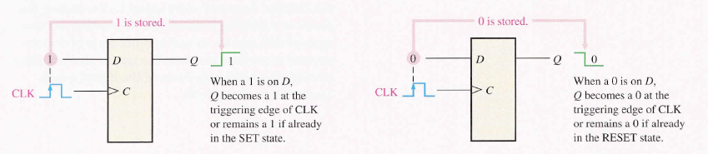

Slide 4
Shift Registers
Another function of a register, besides storage, is to provide for data movements.
Each stage (flip-flop) in a shift register represents one bit of storage, and the shifting capability of a register permits the movement of data from stage to stage within the register, or into or out of the register upon application of clock pulses.

Slide 5
Application of shift register
Shift register is used as Parallel to serial converter, which converts the parallel data into serial data. It is utilized at the transmitter section after Analog to Digital Converter ADC block.
Shift register is used as Serial to parallel converter, which converts the serial data into parallel data. It is utilized at the receiver section before Digital to Analog Converter DAC block.
Shift register along with some additional gates generate the sequence of zeros and ones. Hence, it is used as sequence generator.
Shift registers are also used as counters. There are two types of counters based on the type of output from right most D flip-flop is connected to the serial input. Those are Ring counter and Johnson Ring counter

Slide 6
Shift Registers
Basic data movement in shift registers (four bits are used for illustration).
Data in
Data out
Data out
Data in
(a) Serial in/shift right/serial out
(b) Serial in/shift left/serial out
Data in
Data in
Data in
Data out
Data out
(c) Parallel in/serial out
(d) Serial in/parallel out
Data out
(e) Parallel in / parallel out
(f) Rotate right
(g) Rotate left

Slide 7
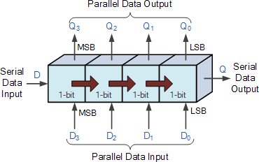
The Shift Register
The Shift Register used for the storage or the transfer of binary data.
Serial-in to Serial-out (SISO) - the data is shifted serially “IN” and “OUT” of the register, one bit at a time in either a left or right direction under clock control.
Serial-in to Parallel-out (SIPO) - the register is loaded with serial data, one bit at a time, with the stored data being available at the output in parallel form.
Parallel-in to Serial-out (PISO) - the parallel data is loaded into the register simultaneously and is shifted out of the register serially one bit at a time under clock control.
Parallel-in to Parallel-out (PIPO) - the parallel data is loaded simultaneously into the register, and transferred together to their respective outputs by the same clock pulse.

Slide 8
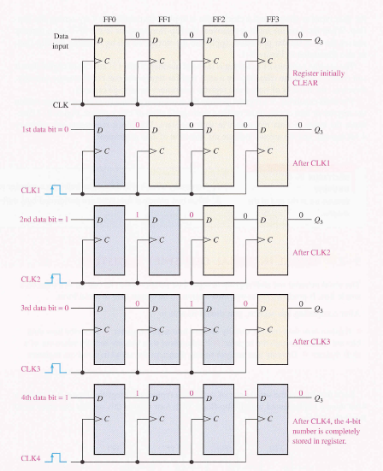
SISO

Slide 9
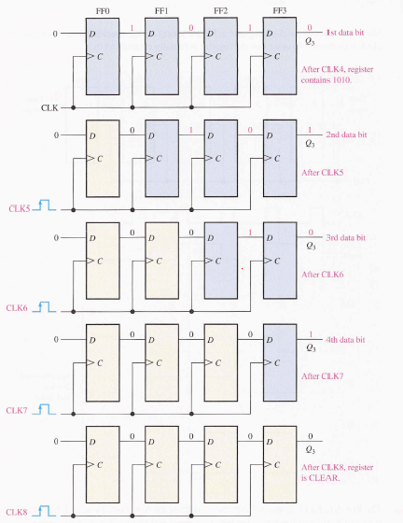

Slide 10
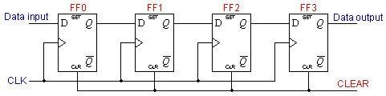
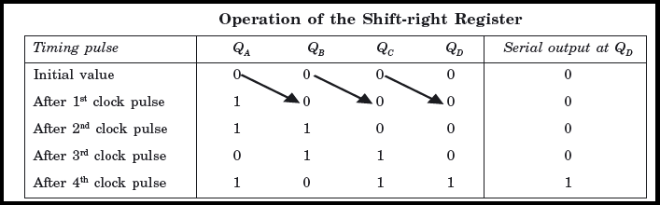
Serial-in to Serial-out (SISO) Shift Register
All the FF are reset and a logical input 1011 is applied at the serial input line connected to stage FF0

Slide 11
MCQ
Shift register consist of an arrangement of flip flops.
Two function of a shift register are data storage and data movement.
In a serial Shift register , several data bits are entered at the same time.
A shift register can have both parallel and serial output.

Slide 12
MCQ
The group of bits 11001 is serially shifted (right-most bit first) into a 5-bit parallel output shift register with an initial state 01110. After three clock pulses, the register contains ________ a) 01110 b) 00001 c) 00101 d) 00110

Slide 13
MCQ
Assume that a 4-bit serial in/serial out shift register is initially clear. We wish to store the nibble 1100. What will be the 4-bit pattern after the second clock pulse? (Right-most bit first) a) 1100 b) 0011 c) 0000 d) 1111

Slide 14
MCQ
With a 200 kHz clock frequency, eight bits can be serially entered into a shift register in ________ a) 4 μs b) 40 μs c) 400 μs d) 40 ms

Slide 15
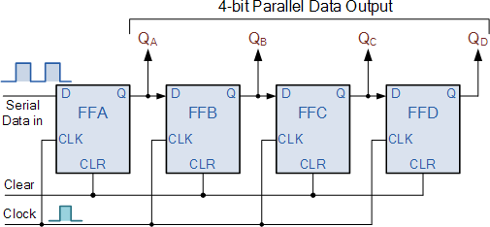
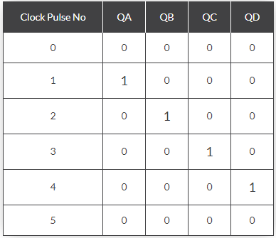
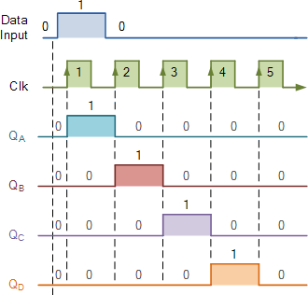
4-bit Serial-in to Parallel-out Shift Register

Slide 16
MCQ
A serial in/parallel out, 4-bit shift register initially contains all 1s. The data nibble 0111 is waiting to enter. After four clock pulses, the register contains ________ a) 0000 b) 1111 c) 0111 d) 1000

Slide 17
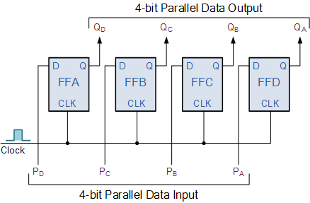
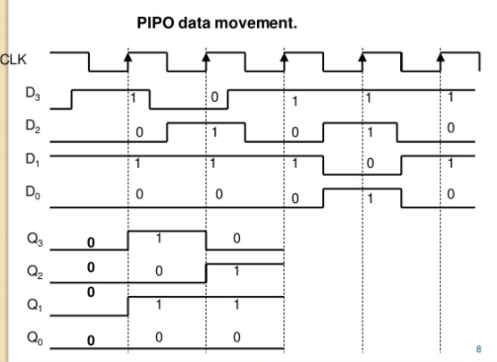
4-bit Parallel-in to Parallel-out Shift Register

Slide 18
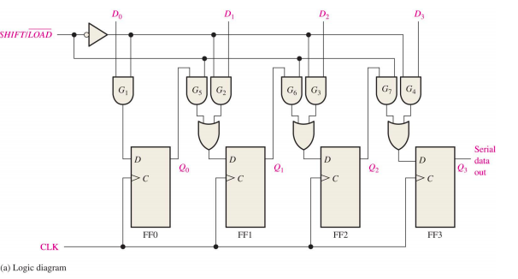
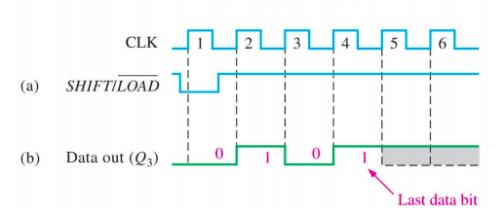
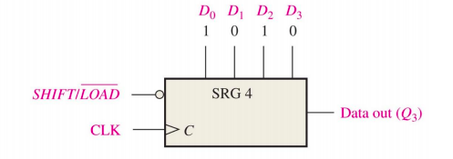
PISO Shift Register
Require 1 clk to load parallel data

Slide 19
Bidirectional shift-register
The register in which the data can be shifted either left of right.
If we shift a binary number to left by one position, this operation is equivalent to multiplying the original number by 2.
If we shift a binary number to right by one position, this operation is equivalent to dividing the original number by 2.
In order to perform these mathematical operations, we need a shift register that can shift the bits in either direction. This can be achieved by Bidirectional Shift Register.

Slide 20
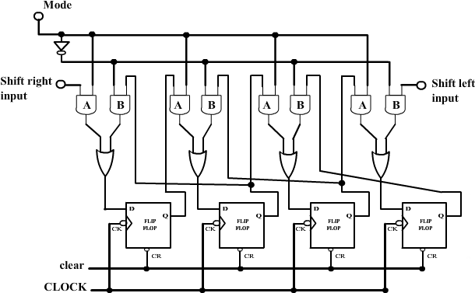
Bidirectional shift-register

Slide 21
Universal Shift Register
The register which can be used to shift the data in both the directions like left, right and can load parallel data as well”.
Universal shift register will load the data either in serial/parallel and will produce output as we require i.e. either in serial/parallel.
This register can perform three types of operations, stated below.
Parallel loading
Shifting left
Shifting right.

Slide 22
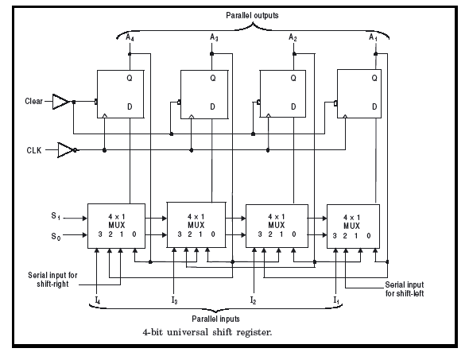
Universal Shift Register

Slide 23
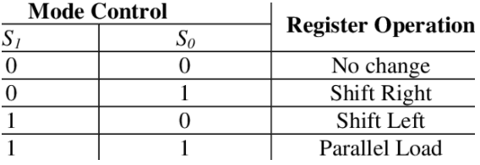

Slide 24
Ring Counter
It is a type of counter in which the output of the last flip flop is connected as an input to the first flip-flop is known as a Ring counter.
The input is shifted between the flip-flops in a ring shape , so it is known as a Ring counter.
There are two types of the Ring counter.
A Typical Ring Counter
Johnson counter

Slide 25
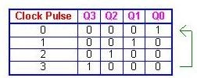
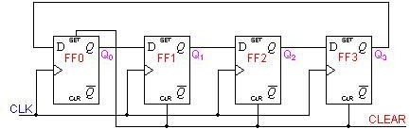
Ring Counter
A Ring counter is a synchronous counter. The synchronous counter has a common clock signal that triggers all the Flip-flops at the same time.
Ring counter consists of D-flip flops connected in cascade setup with the output of last Flip-flop connected to the input of first Flip-flop.
Ring counter has Mod = n ‘n’ is the number of bits. It means 4-bit ring counter has 4 states.
Ring counter divides the frequency of the clock signal by ‘n’.
n is the bit size of the ring counter. So ring counter can be used as a frequency divider.

Slide 26
Merits
Can be implemented using D and JK flip-flops. It is a self-decoding circuit.
Demerits
A ring counter of n-bits has only n valid states instead of 2^{n}. This makes them inefficient in terms of state-usage.

Slide 27
MCQ
If a 10-bit ring counter has an initial state 1101000000, what is the state after the second clock pulse? a) 1101000000 b) 0011010000 c) 1100000000 d) 0000000000

Slide 28
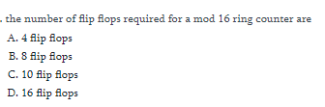
MCQ

Slide 29
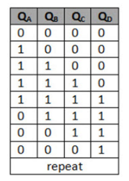
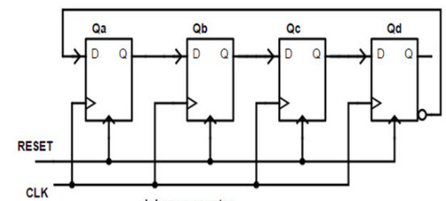
Johnson or Twisting Ring Counter
The Johnson counter is a modification of ring counter.
In this the inverted output of the last stage flip flop is connected to the input of first flip flop.
If we use n flip flops to design the Johnson counter, it is known as 2n bit Johnson counter or Mod 2n Johnson counter.
Last FF output(~Q) feed back input to first FF Count 2n clock pulse
MOD-2N counter

Slide 30
This is an advantage of the Johnson counter that it requires only half number of flip flops that of a ring counter uses, to design the same Mod.
Johnson counter divides a clock signal’s frequency by ‘2n’. n is the bit size of the counter.
2-stage Johnson counter, also known as quadrature oscillator produce 4 outputs with 90-degree phase shift. It can easily drive a 2-phase stepper motor.
3-stage Johnson counter is used as 3-phase square wave generator having 120-degree phase shift between them.
5-stage Johnson counter is used as decade counter or decade divider.

Slide 31
MCQ
Which is true for Register ?
(a) Temporary data storage
(b) Data transfer
(c)Data manipulation
(d) All above
What are the different types of register?
SISO
PIPO
SIPO
All the above

Slide 32
MCQ
Ring shift and Johnson counters are ____________ a) Synchronous counters b) Asynchronous counters c) True binary counters d) Synchronous and true binary counters

Slide 33
MCQ
In a 4-bit Johnson counter sequence, there are a total of how many states or bit patterns? a) 1 b) 3 c) 4 d) 8

Slide 34
MCQ
How many number of pulse count by 6-bit Johnson counter count?
3
6
12
64

Slide 35
MCQ

